Slide 1
Recap: Critical points of a vdw gas
The critical state (e.g., $T_{crit}$, $V_{crit}$, and $P_{crit}$) can be derived for a vdw gas by noticing that it’s an inflection point:
${\left(\frac{∂P}{∂V}\right)}_{T}=0$ and ${\left(\frac{∂^{2}P}{∂V^{2}}\right)}_{T}=0$
The results are
$$T_{crit}=\frac{8}{27}\frac{a}{Rb}≈\frac{1}{3}\frac{a}{Rb}$$
$$V_{crit}=n3b$$
$$P_{crit}=\frac{a}{27b^{2}}$$

Slide 2
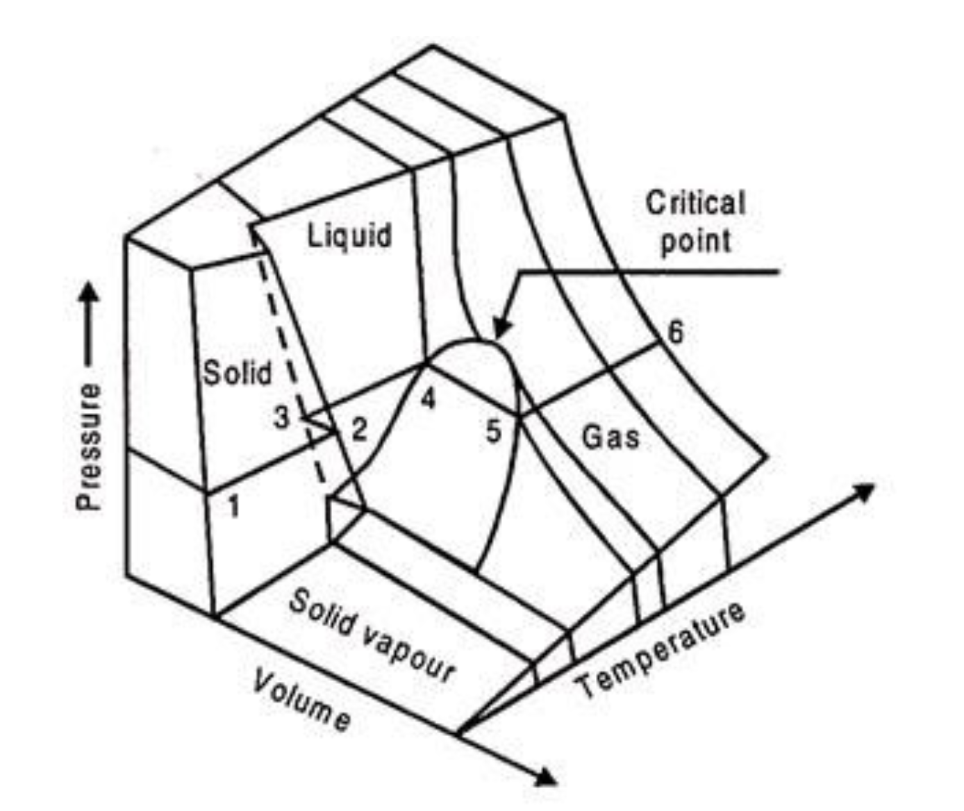

Here’s $T_{crit}$ in our “corresponding states” diagram
$T_{crit}≈\frac{1}{3}\frac{a}{Rb}$ (for a vdw gas)
https://www.engineeringenotes.com/thermal-engineering/real-gases/real-gases-properties-van-der-waals-equation-and-equation-of-state-thermal-engineering/49112

Slide 3

$T_{Boyle}$ is hotter than $T_{crit}$
$T_{Boyle}≈\frac{a}{Rb}$
$T_{crit}≈\frac{1}{3}\frac{a}{Rb}$
https://www.engineeringenotes.com/thermal-engineering/real-gases/real-gases-properties-van-der-waals-equation-and-equation-of-state-thermal-engineering/49112

Slide 4
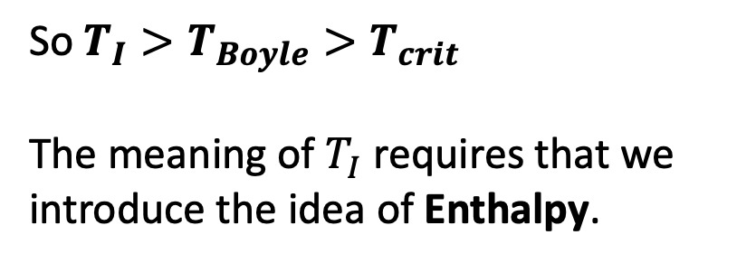

Even hotter is another temperature called the inversion temperature (which we’ll get to)
$$T_{I}≈2\frac{a}{Rb}$$
$T_{Boyle}≈\frac{a}{Rb}$
$T_{crit}≈\frac{1}{3}\frac{a}{Rb}$
So $T_{I}>T_{Boyle}>T_{crit}$
The meaning of $T_{I}$ requires that we introduce the idea of Enthalpy.
https://www.engineeringenotes.com/thermal-engineering/real-gases/real-gases-properties-van-der-waals-equation-and-equation-of-state-thermal-engineering/49112

Slide 5
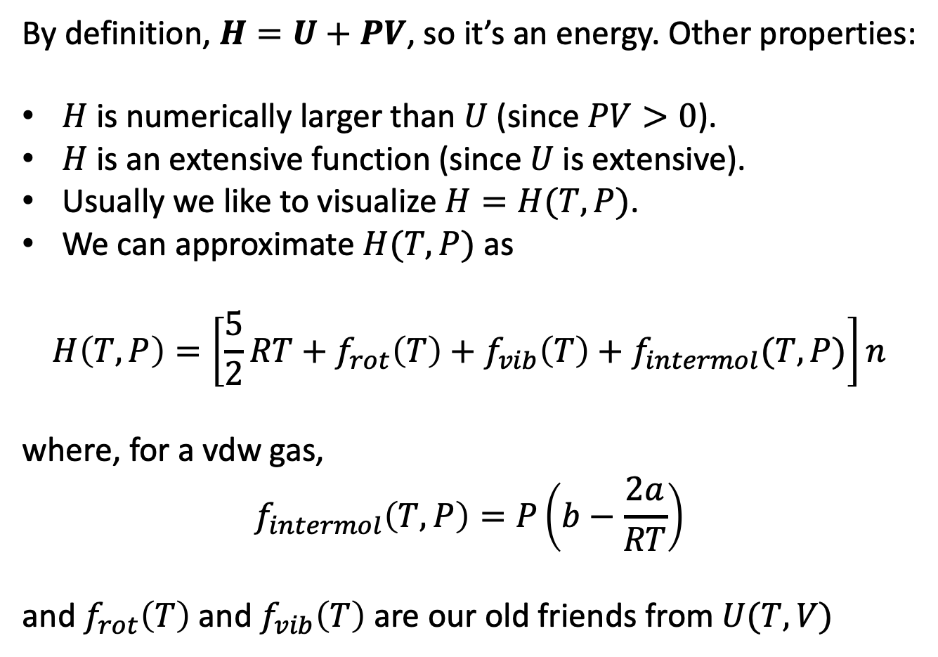
Introducing the Enthalpy, $H$
By definition, $H=U+PV$, so it’s an energy. Other properties:
$H$ is numerically larger than $U$ (since $PV>0$).
$H$ is an extensive function (since $U$ is extensive).
Usually we like to visualize $H=H(T,P)$.
We can approximate $H(T,P)$ as
$$H\left(T,P\right)=\left[\frac{5}{2}RT+f_{rot}\left(T\right)+f_{vib}\left(T\right)+f_{intermol}(T,P)\right]n$$
where, for a vdw gas,
$$f_{intermol}\left(T,P\right)=P\left(b−\frac{2a}{RT}\right)$$
and $f_{rot}\left(T\right)$ and $f_{vib}\left(T\right)$ are our old friends from $U(T,V)$

Slide 6
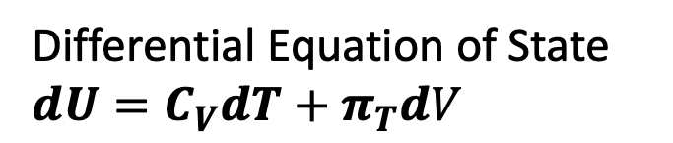
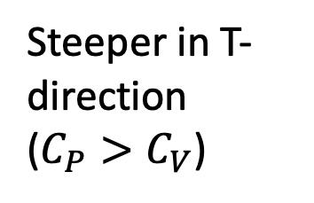
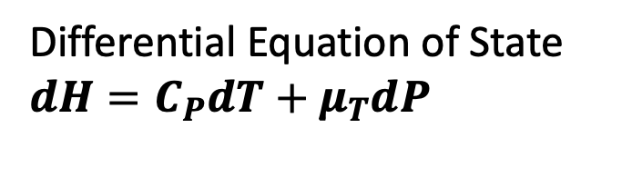
Slopes of $H\left(T,P\right)$ compared to $U\left(T,V\right)$
Differential Equation of State
$$dU=C_{V}dT+π_{T}dV$$
Differential Equation of State
$$dH=C_{P}dT+μ_{T}dP$$
U(T,V)
H(T,P)
Steeper in T-direction ($C_{P}>C_{V}$)
V
P
T
T
T-V state space
T-P state space

Slide 7
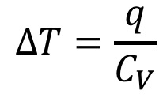
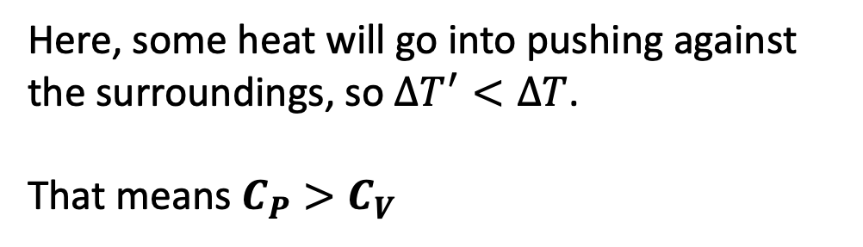
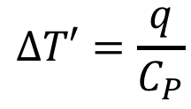
Why $C_{P}>C_{V}$ … the physical argument
w
q
$$∆T=\frac{q}{C_{V}}$$
q
$$∆T′=\frac{q}{C_{P}}$$
Here, some heat will go into pushing against the surroundings, so $∆T^{′}<∆T$.
That means $C_{P}>C_{V}$

Slide 8
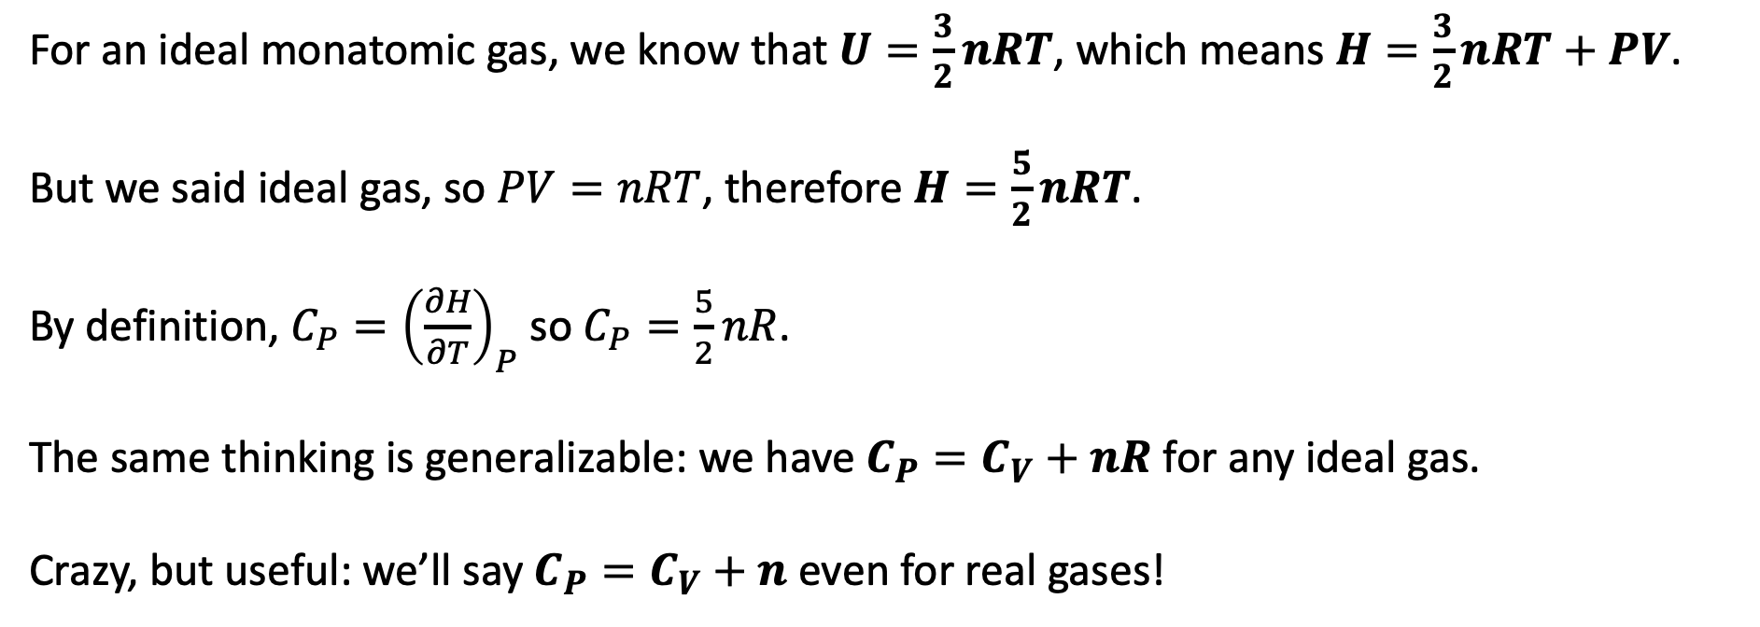
Why $C_{P}>C_{V}$ … the mathematical argument
For an ideal monatomic gas, we know that $U=\frac{3}{2}nRT$, which means $H=\frac{3}{2}nRT+PV$.
But we said ideal gas, so $PV=nRT$, therefore $H=\frac{5}{2}nRT$.
By definition, ${C_{P}=\left(\frac{∂H}{∂T}\right)}_{P}$ so $C_{P}=\frac{5}{2}nR$.
The same thinking is generalizable: we have $C_{P}=C_{V}+nR$ for any ideal gas.
Crazy, but useful: we’ll say $C_{P}=C_{V}+n$ even for real gases!

Slide 9
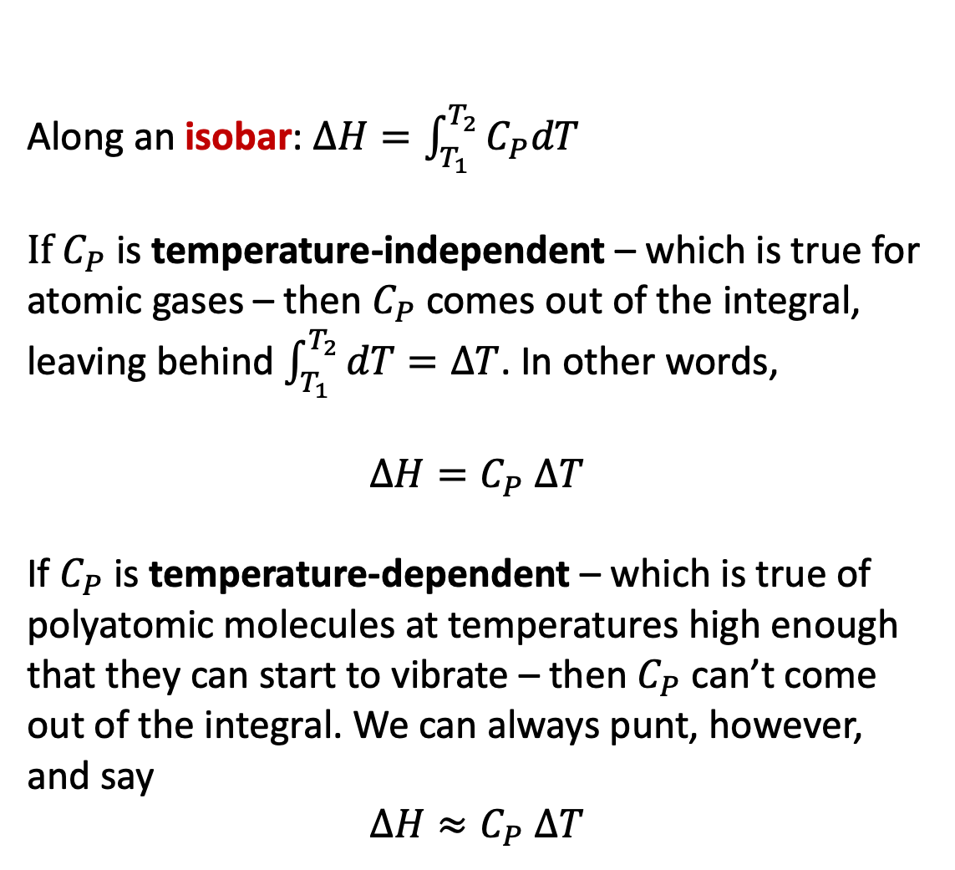
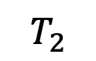
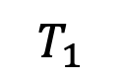
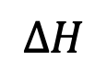
Finding changes in enthalpy ($∆H$) along an isobar
Along an isobar: $∆H=\int_{T_{1}}^{T_{2}}{C_{P}dT}$
If $C_{P}$ is temperature-independent – which is true for atomic gases – then $C_{P}$ comes out of the integral, leaving behind $\int_{T_{1}}^{T_{2}}{dT}=∆T$. In other words,
$∆H=C_{P}$ $∆T$
If $C_{P}$ is temperature-dependent – which is true of polyatomic molecules at temperatures high enough that they can start to vibrate – then $C_{P}$ can’t come out of the integral. We can always punt, however, and say
$$∆H≈C_{P} ∆T$$
$$∆H$$
$$T_{2}$$
$$T_{1}$$

Slide 10
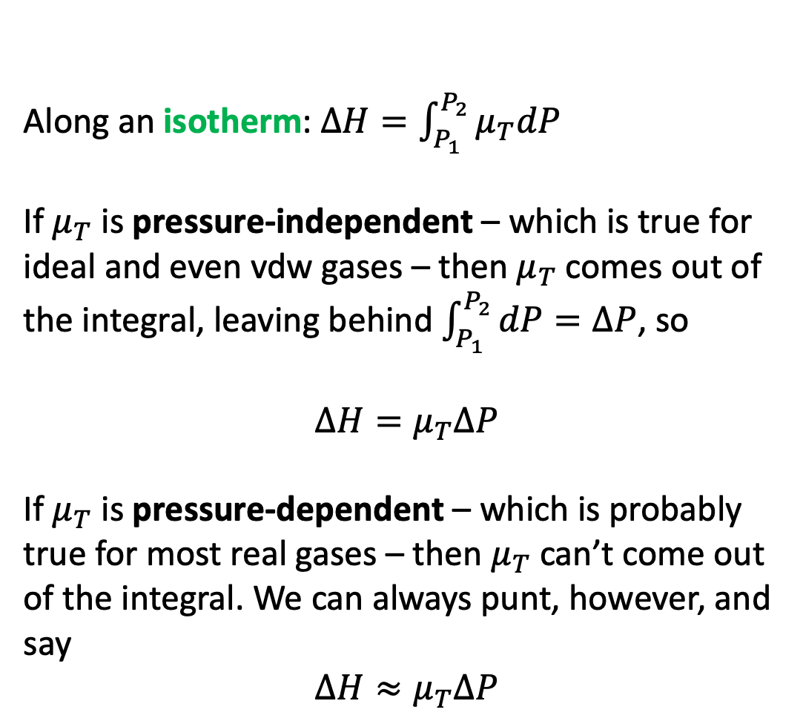
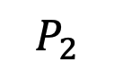
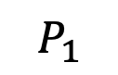
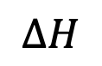
Finding changes in enthalpy ($∆H$) along an isotherm
Along an isotherm: $∆H=\int_{P_{1}}^{P_{2}}{μ_{T}dP}$
If $μ_{T}$ is pressure-independent – which is true for ideal and even vdw gases – then $μ_{T}$ comes out of the integral, leaving behind $\int_{P_{1}}^{P_{2}}{dP}=∆P$, so
$$∆H=μ_{T}∆P$$
If $μ_{T}$ is pressure-dependent – which is probably true for most real gases – then $μ_{T}$ can’t come out of the integral. We can always punt, however, and say
$$∆H≈μ_{T}∆P$$
$$P_{1}$$
$$∆H$$
$$P_{2}$$

Slide 11
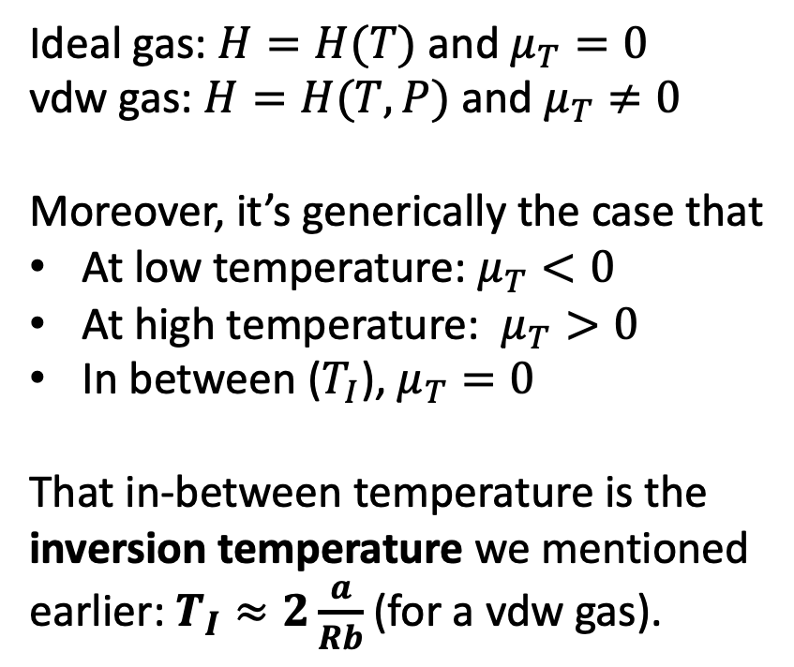
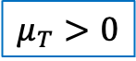
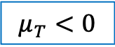
The twist and the inversion temperature
Ideal gas: $H=H(T)$ and $μ_{T}=0$
vdw gas: $H=H(T,P)$ and $μ_{T}≠0$
Moreover, it’s generically the case that
At low temperature: $μ_{T}<0$
At high temperature: $μ_{T}>0$
In between ($T_{I}$), $μ_{T}=0$
That in-between temperature is the inversion temperature we mentioned earlier: $T_{I}≈2\frac{a}{Rb}$ (for a vdw gas).
$$μ_{T}>0$$
$$μ_{T}<0$$

Slide 12
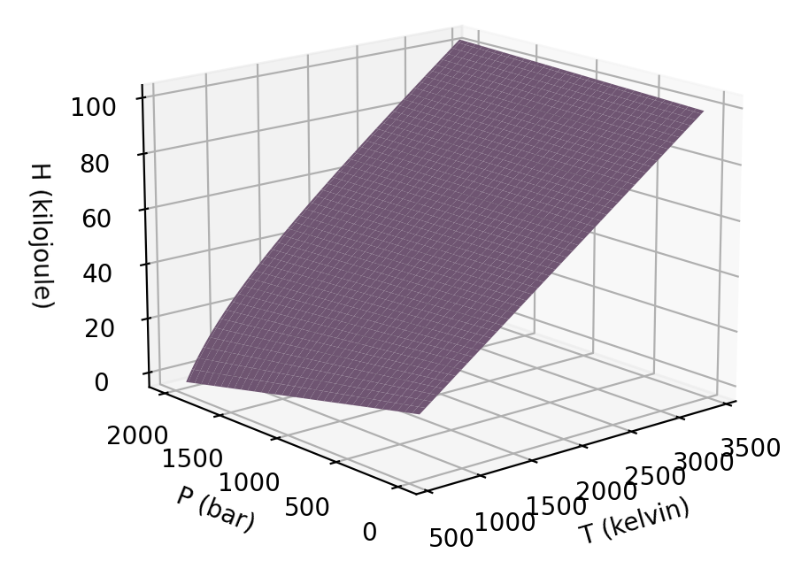
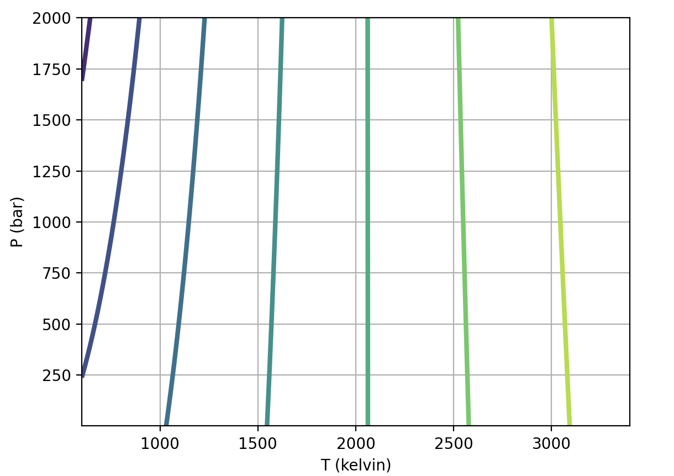

When the twist is hard to see, we can fall back on contours of constant $H$ (AKA isenthalps)
The isenthalp that goes straight up/down must have $μ_{T}=0$. That’s the inversion temperature!

